Slide 1

CC 141 Discrete Structures Department of Computer Science School of Systems and Technology University of Management and Technology Lahore, Pakistan

Slide 2
Section 1.2
Application of Propositional Logic

Slide 3
Application of Logic
Translating English Sentences
System Specifications
Boolean Searches
Logic Puzzles
Logic Circuits

Slide 4
Translating English Sentences
Step 1 : find logical connectives
Step 2: break the sentence into basic propositions
Step 3: rewrite the sentence in propositional logic

Slide 5
Translating English Sentences
Example:
If you are senior citizen and it is a Tuesday, then you can have free coffee
Step 1 : find logical connectives
Example:
If you are senior citizen and it is a Tuesday, then you can have free coffee
Step 1 : find logical connectives
Step 2: break the sentence into basic propositions

Slide 6
Translating English Sentences
Step 2: break the sentence into basic propositions
Example:
if you are senior citizen and it is a Tuesday then
a b
you can have free coffee
c

Slide 7
Translating English Sentences
Step 3: rewrite the sentence in propositional logic
Example:
if you are senior citizen and it is a Tuesday then
a b
you can have free coffee
c
a Ʌ b → c

Slide 8
System Specifications
“The automated reply cannot be sent when the file system is full”

Slide 9
System Specifications
p=“The automated reply can be sent”
q=“The file system is full.”
Then ￢p represents “It is not the case that the automated reply can be sent,” which can also be expressed as “The automated reply cannot be sent.”

Slide 10
System Specifications
“The automated reply cannot be sent when the file system is full”
p=“The automated reply can be sent”
q=“The file system is full.”
Consequently, our specification can be represented by the conditional statement
q →￢p

Slide 11
Boolean Searches

Slide 12
Boolean Searches
Logical connectives are used extensively in searches of large collections of information, such as indexes of Web pages. Because these searches employ techniques from propositional logic, Links they are called Boolean searches
Example: Web Search:
UMT AND CS AND DISCRETE
UMT OR CS OR DISCRETE

Slide 13
Logical Puzzles
Puzzles that can be solved using logical reasoning are known as logic puzzles

Slide 14
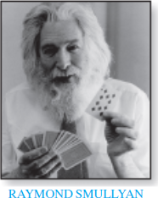



Examples – Logical Puzzles

Slide 15
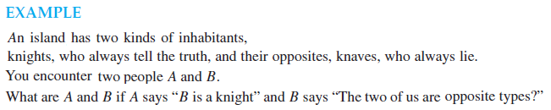


Examples – Logical Puzzles

Slide 16
Logical Circuits
Switches “in series”
Switches “in parallel”

Slide 17
Switching Circuits – Series Circuit
AND
Switches | Light Bulb
P Q | State
Closed Closed | On
Closed Open | Off
Open Closed | Off
Open Open | Off

Slide 18
Switching Circuits – Parallel Circuit
OR
Switches | Light Bulb
P Q | State
Closed Closed | On
Closed Open | On
Open Closed | On
Open Open | Off

Slide 19
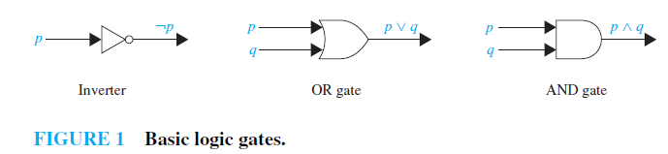
Logic Circuits

Slide 20
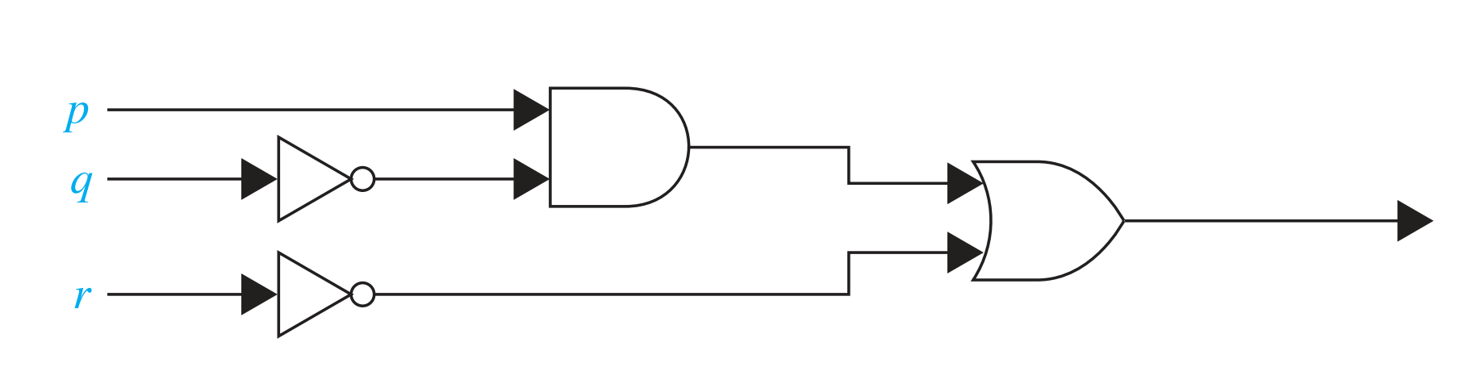
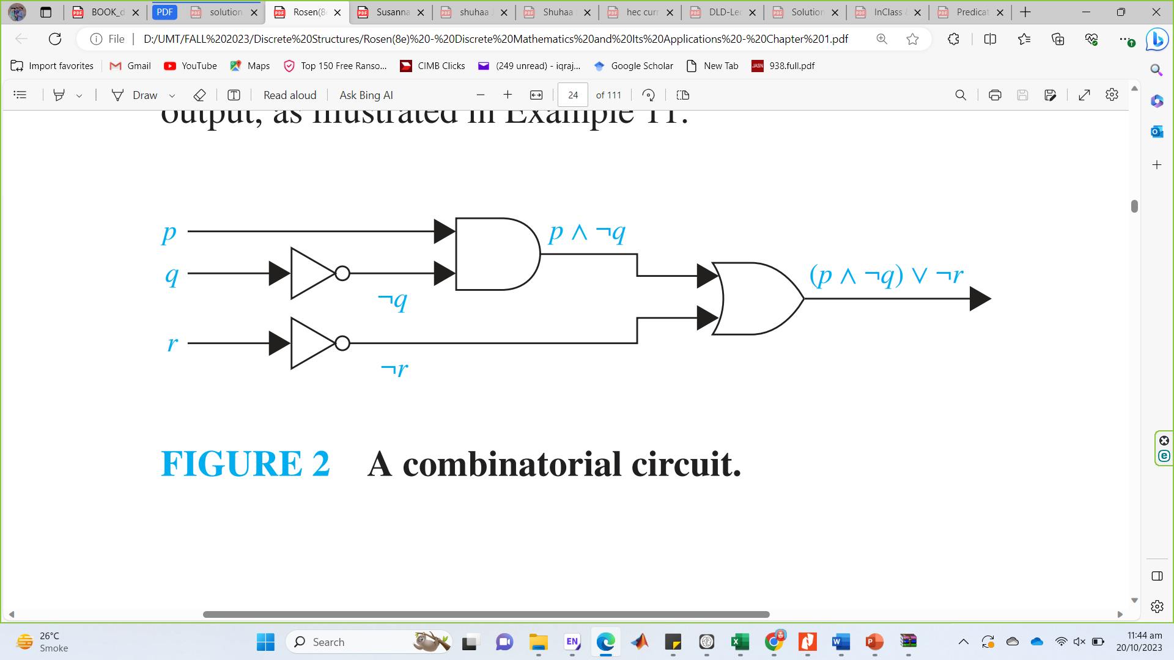
Logic Circuits
Determine the output for the combinatorial circuit in following Figure

Slide 21
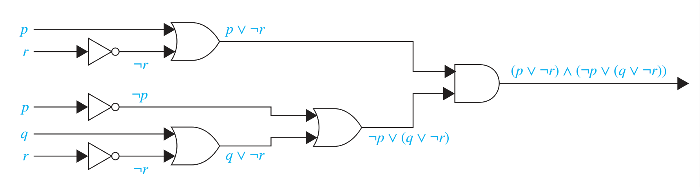
Logic Circuits
Build a digital circuit that produces the output
(p ∨￢r) ∧ (￢p ∨ (q ∨￢r))
when given input bits p, q, and r.

Slide 22

Summary
1.2 Application of Propositional Logic
Translating English Sentences
System Specifications
Boolean Searches
Logic Puzzles
Logic Circuits

